Slide 1
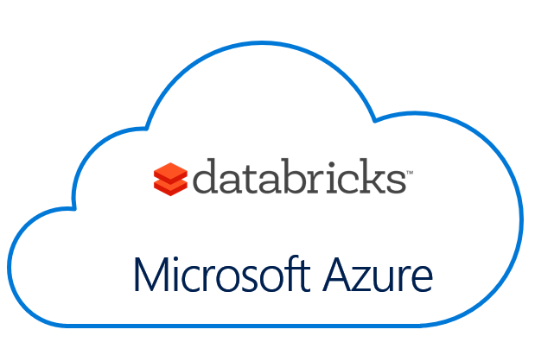





Azure Databricks Using Open Source Libraries Bryan Cafferky Data Solutions Enabler
https://github.com/bcafferky/shared

Slide 2




Azure
Easy
Cluster Creation
Scheduling
Big Data
Notebooks
Security
Collaboration

Slide 3
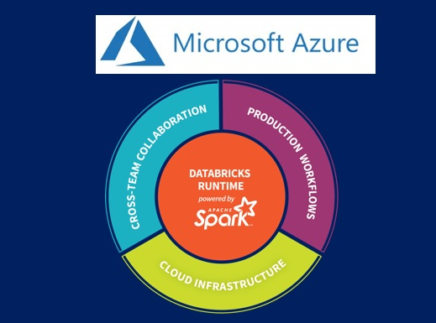
Azure Databricks: Using Open SourceLibraries

Slide 4
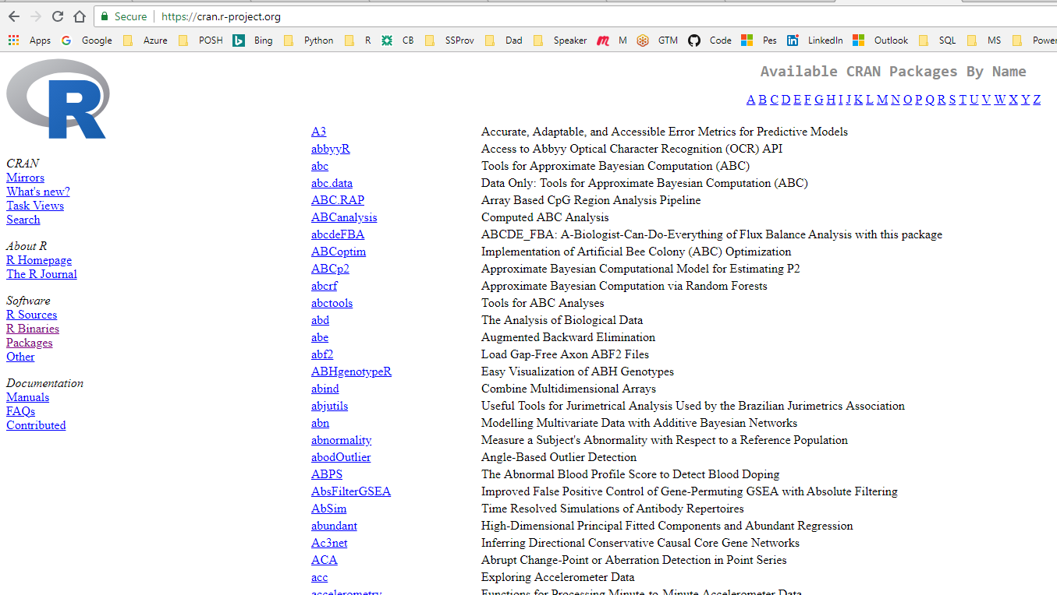
Azure Databricks: Using Open Source Libraries

Slide 5
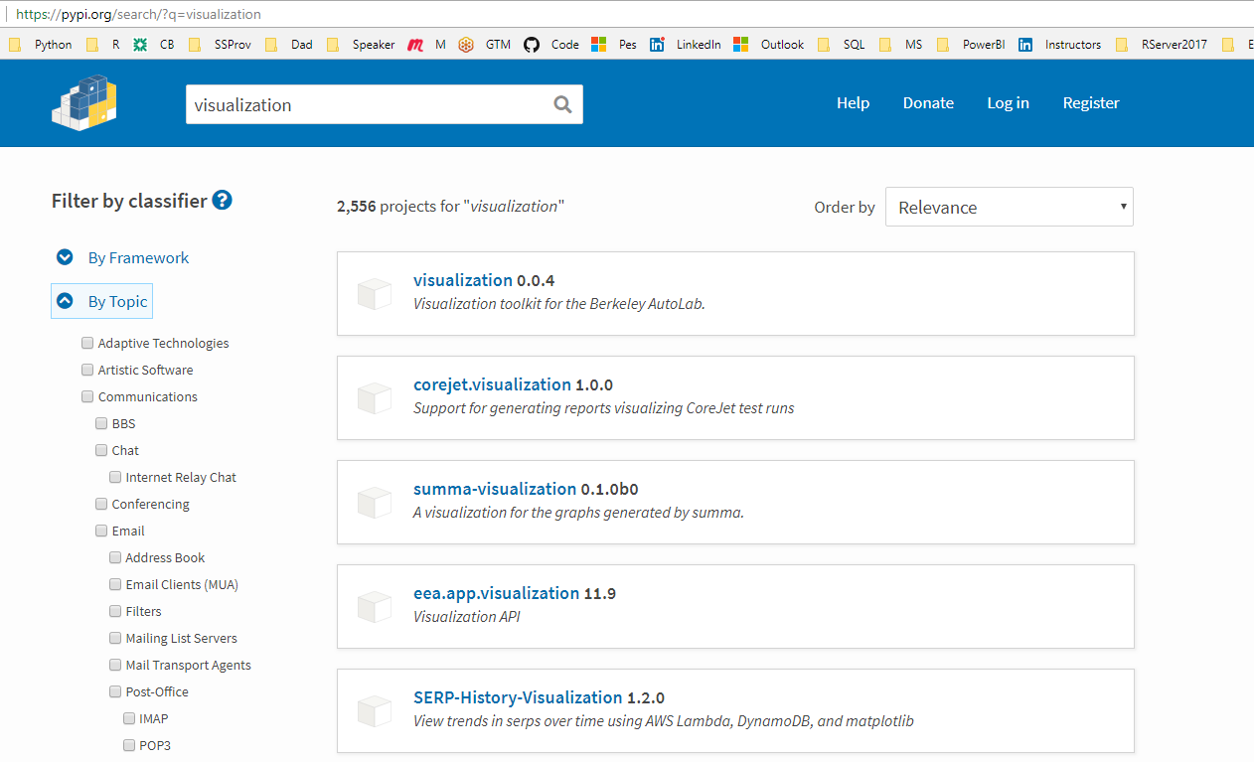
Azure Databricks: Using Open Source Libraries

Slide 6

Azure Databricks Using Open Source Libraries Bryan Cafferky Data Solutions Enabler
https://github.com/bcafferky/shared

